Slide 1



EXTERNSHIP PROJECT
INFRACTIONS AND SEVERITY ANALYSIS
ANUSHA MUDUNDI & RUTH TIMAS

Slide 2
INTRODUCTION
Business Question: Is there a relationship between Total Infractions and the Severity of actions taken by the Health Unit?
Objective:
To determine whether there is a positive, negative, or no correlation between these two variables.
We also seek to analyze trends and patterns, particularly focusing on whether an increase in infractions consistently results in more severe actions.
Understanding the Variables:
Severity Rank: A numeric representation of the severity of actions taken. Severity ranks range from 1 to 21 For example, No actions required = 1 and Closure or Suspension = 21.
Total Infraction Count: Represents the average number of infractions associated with each action category.

Slide 3
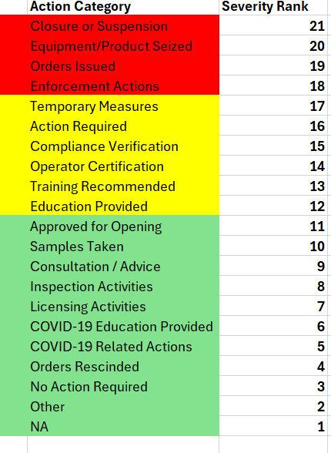
SEVERITY RANK CATEGORISATION

Slide 4
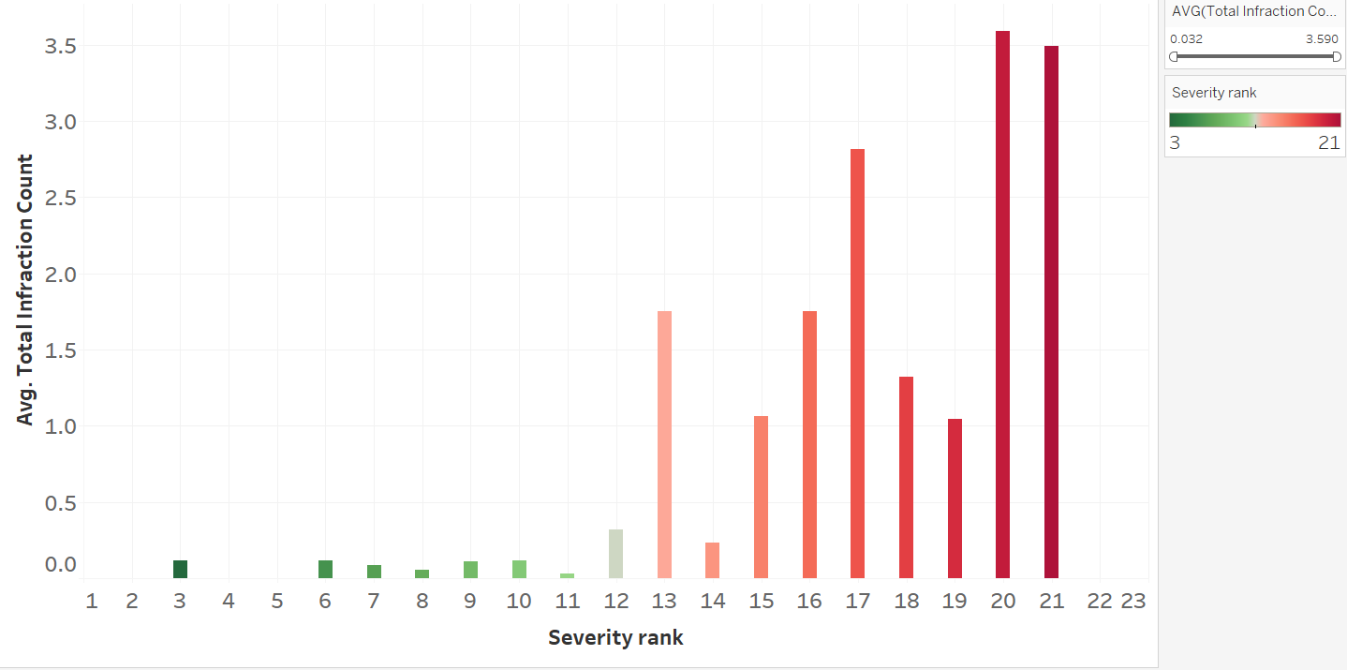
TOTAL INFRACTION COUNT BY SEVERITY RANK
X-axis: Severity Rank - The severity of actions taken, ranked from less to more severe.
Y-axis: Total Infraction Count - Shows the total number of infractions associated with each severity rank.
Aim of Analysis: To uncover how the severity rank of actions corresponds to the average total number of infractions.
Key Insight: Higher severity ranks generally correspond to a higher average number of infractions.

Slide 5
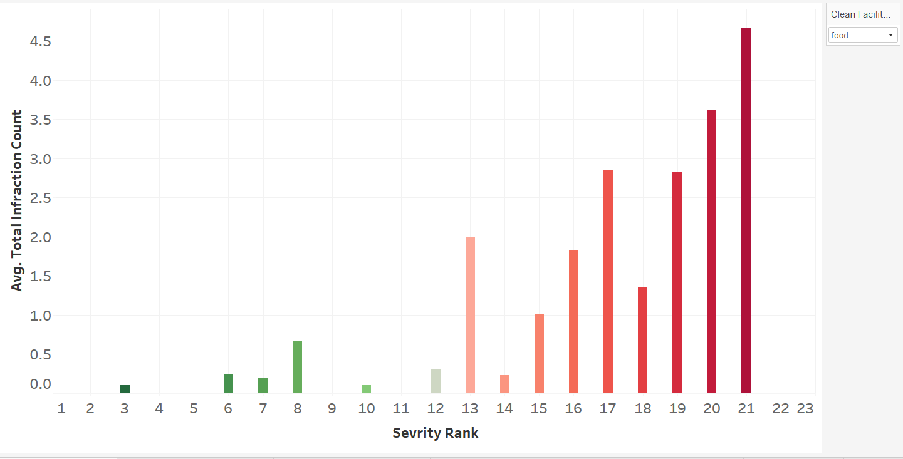
TREND OVER FACILITY TYPE
Most facilities display a positive correlation between the severity rank and the average total infraction count.
The chart specifically highlights food facilities, which exhibit higher infraction counts compared to other types of facilities.

Slide 6
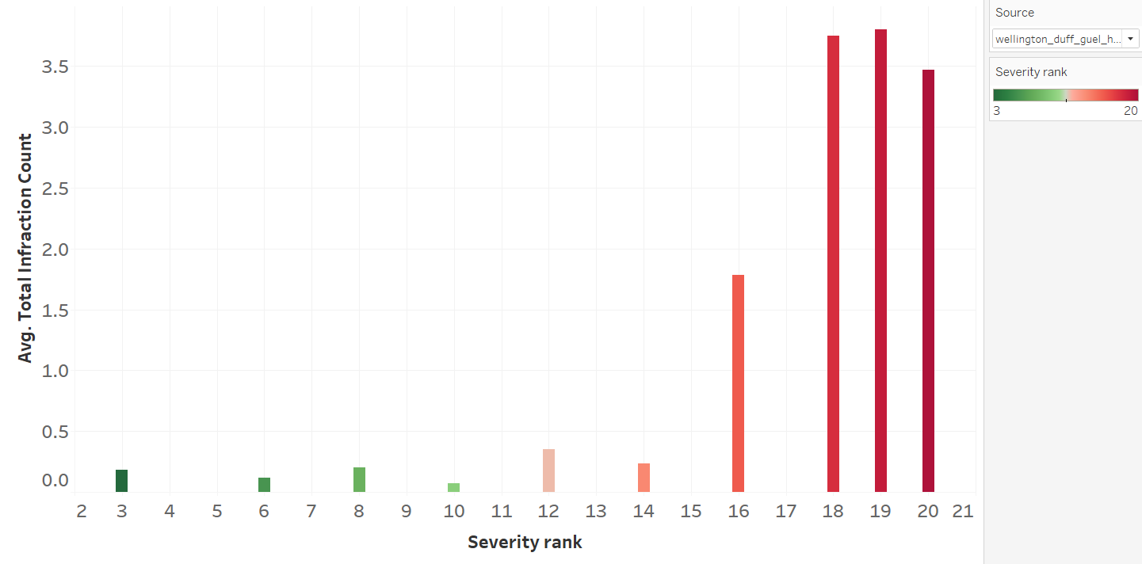
The relationship between the two variables is generally consistent, except for the Wellington Health Unit, which exhibits a distinct pattern compared to other health units.
Wellington Health Unit shows high severity ranks (19-21) dominating the infractions analysis.
The infraction counts escalate significantly at higher severity levels, suggesting Wellington's facilities face more severe issues or have stricter inspections compared to other regions.
TREND OVER SOURCE

Slide 7
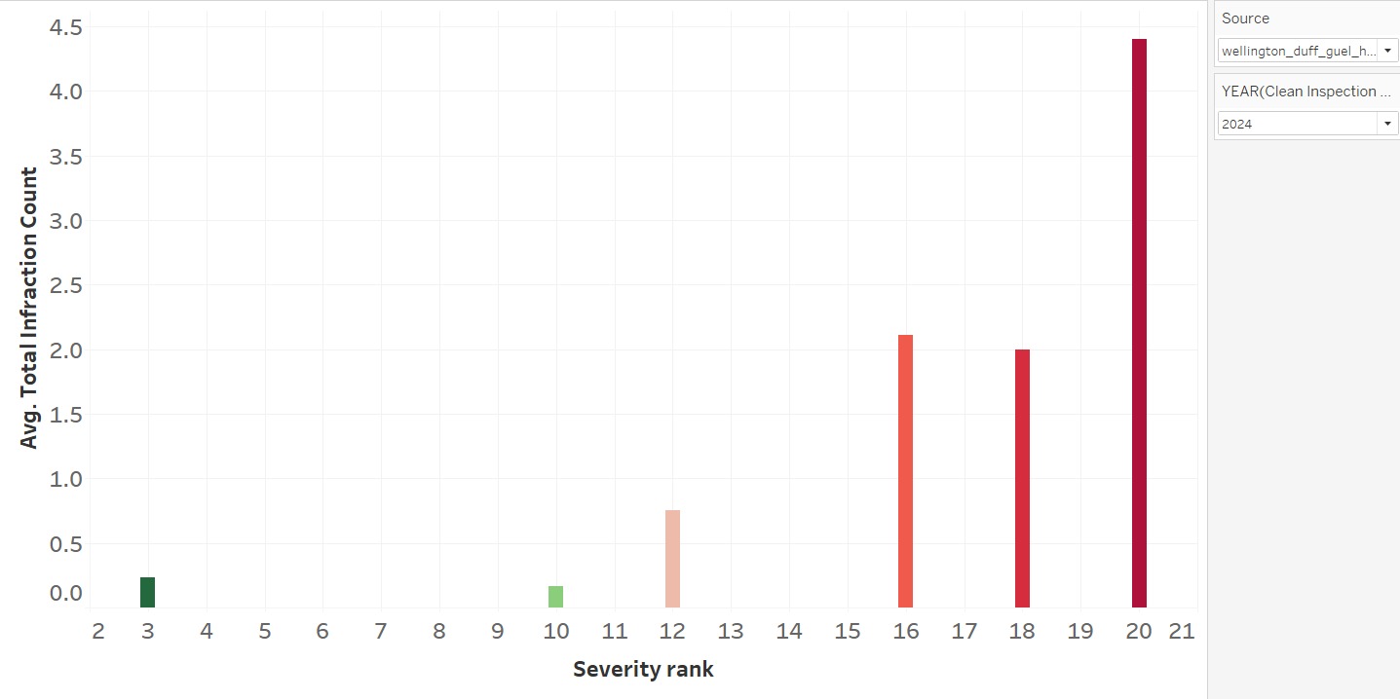
TREND OVER TIME
In 2024, the Wellington Health Unit saw a notable trend in infractions and their severity ranks.
There was a significant increase in infractions with higher severity ranks, which corresponded to a higher average total infraction count.
This indicates that the health unit faced more critical infractions that required stringent actions compared to previous years.

Slide 8
CONCLUSION
Positive Correlation: Higher infraction counts generally lead to more severe actions by health units.
Severity Variability: Despite the overall trend, severity of actions can vary for similar infraction levels.
Food Facility Risk: Food facilities consistently show higher infraction counts than other types.
Regional Anomaly: Wellington Health Unit exhibited an unusual spike in severe infractions in 2024.
Wellington Risk Increase: Wellington's higher infraction counts for top severity ranks indicate elevated food safety risks in this region.
Data Gaps: Some data limitations exist, potentially affecting the completeness of the analysis.
RECOMMENDATIONS
• Develop a Risk-Tiered Pricing Model: Create insurance premiums that dynamically adjust based on facility type, previous infraction rates, and regional risk profiles, with special consideration for food facilities.
• Implement Proactive Risk Management: Offer premium incentives for clients who demonstrate robust food safety compliance and invest in preventative risk management strategies.

